Slide 1
2023 PHA Plan Resident Meeting
August 11th, 2022 | The Terrace, Tulane, Parks Place
August 16th, 2022 | Gibbs Village East + West
August 17th, 2022 | Paterson Court

Slide 2
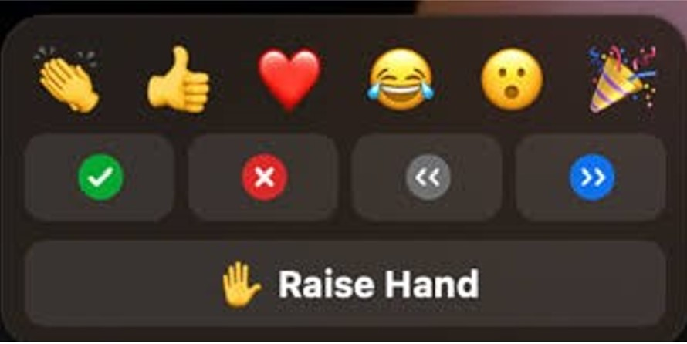
Zoom Etiquette
Be aware of your audio and video settings – video is not required to attend
Make sure your microphone is muted when not speaking (Bottom Left Corner)
Avoid speaking over other attendees or hosts
Make sure you are dressed appropriately with limited distractions around you if using video (Bottom Left Corner)
Use the “Raise Hand” feature to ask a question
You’re welcome to use the chat box for any questions you may have (Bottom Middle)
The chat box will be continuously monitored for questions.

Slide 3
PUBLIC REVIEW DOCUMENTS
Draft Annual Agency Plan FYB 2023
Capital Fund Five Year Action Plan (FYB 2023-2027)

Slide 4
PRESENTATION TO INCLUDE:
Overview of the Annual Agency Plan and Capital Action Plan
Plan Format (Form HUD 50075-ST)
Real Estate and Community Development Updates
Public Safety Updates
Project-Based Voucher (PBV) Program Updates
Resident Services (FSS) Updates
Capital Fund Program Five Year Action Plan
Next Steps
Public Review/Comment Period
Public Hearing
Presentation to the Board of Commissioners

Slide 5
What is the PHA Plan?
Public Housing Authority (PHA)
The Annual and 5-Year Plans will outline the Agency’s policies, programs, services, and strategies it intends to operate and adding the fiscal year of 2023.
The Capital Action Plan describes strategic priorities, capital improvements, and redevelopment activities.
Categorized as a standard PHA, MHA will submit the Annual Plan using Form HUD 50075-ST (standard template).

Slide 6
Submission Requirements
Certification Forms…
HUD form 50075-ST – Annual PHA Plan
HUD 50077-ST-HCVP-HP – Certifications of Compliance with the PHA Plans and related Regulations
Form HUD 50077-SL – a certification by a State or Local official of the Annual PHA Plan’s consistency with the City’s Consolidated Plan including the Analysis of Impediments to Fair Housing Choice (AI)
Form HUD 50077-CR – Civil Rights Certification

Slide 7
New Activities

Slide 8
New Activities
Choice Neighborhood Initiative (CNI)
Property Acquisition
Demolition/ Disposition
RAD/ Section 18 Blend
Public Safety
Project-Based Vouchers (PBV)
Family Self-Sufficiency (FSS)

Slide 9
Choice Neighborhoods Initiative (CNI)
Choice Neighborhoods Planning Grants support the development of comprehensive neighborhood revitalization plans which focused on directing resources to address three core goals: Housing, People and Neighborhoods. To achieve these core goals, communities must develop and implement a comprehensive neighborhood revitalization strategy, or Transformation Plan.
The Paterson Court grant will be used to bring the community and planning partners together to create a viable and actionable Transformation Plan in the Centennial Hill Neighborhood.

Slide 10
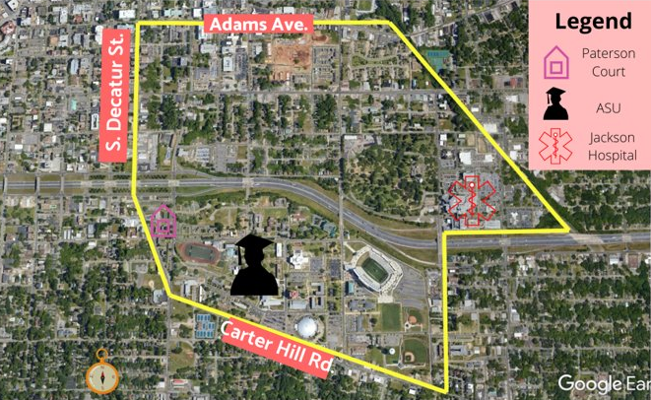
Choice Neighborhoods Initiative (CNI) (Cont’d)
Relocation Plan
A relocation plan for Paterson Court residents has been drafted.
The execution of the plan is contingent on whether MHA is successful in securing a CNI Implementation Grant.
Planning Grant is for a 24-month period (January 2021-December 2022)
MHA is currently in the 19th month of the CNI planning period.
If feasible, MHA will apply for the implementation grant for the current year. If not, MHA will apply for the implementation grant in 2023.

Slide 11
Property Acquisition
The MHA has partnered with the City to secure 43 state-owned vacant/blighted parcels in the Centennial Hill community for CNI redevelopment.
The MHA is currently in negotiations to purchase 7 parcels adjacent to Parks Place for the expansion of parking facilities.
The MHA is considering the acquisition/development of a designated senior living facility.

Slide 13
Demolition/ Disposition and Conversion
Disposition approval for Paterson Court
MHA will continue to seek out potential interested developers and/ or buyers for the former Cedar Park and Smiley Courts housing sites to accomplish the MHA’s community revitalization goals. These options may include Fair Market Value and/or land swap transactions, as may be approved by HUD.
MHA intends to utilize this option with Paterson Court.

Slide 14
Rental Assistance Demonstration (RAD)
MHA intends to apply for RAD for the units at Smiley Court that were vacant at the time of the HUD demolition application approval and did not subsequently receive tenant relocation vouchers. Under this approach, MHA will expand access for quality affordable housing at Columbus Square, Plaza Centennial Hill and other potential off-site locations. MHA expects to apply for up to 147 units which will consist of a mix of multi-family 1, 2, and 3-bedroom units and/or single family, 3 and 4-bedroom units. This conversion of assistance is for units approved for demolition at Smiley Court.
Additionally, MHA will further explore direct RAD transfer of assistance for the ACC units in the mixed-finance developments at The Plaza at Centennial Hill Phase I and Phase II in the upcoming year.
Additionally, the Montgomery Housing Authority is currently compliant with all fair housing and civil rights requirements and is not under a Voluntary Compliance Agreement

Slide 15
Public Safety
Security Camera Installation (Agency wide)
Completed
Lighting Improvements (Agency wide)
In progress
Increased Police Presence
MHA Crime Line
Anonymous hotline for reporting criminal activity
Call: (334)387-3140

Slide 16
Public Safety (Cont’d)
Neighborhood Watch Meetings
Every 2nd Tuesday
Gibbs West @ 5:00pm
Every 2nd Wednesday
The Terrace @ 2:00pm
Tulane @ 5:00pm
Every 2nd Thursday
Paterson Court @ 5:00pm
Every 3rd Wednesday
Gibbs East @ 5:00pm
Every 3rd Thursday
Parks Place @ 5:00pm

Slide 17
Project-Based Vouchers (PBV)
Considering expansion of the PBV program in privately owned properties. Other efforts to increase the supply of affordable housing in Montgomery include:
Reviewing PBVs under the Housing Choice Voucher program, in conjunction with joint partnerships with private owners
Property acquisitions and new construction efforts
These efforts may also include joint partnerships with the private sector, to the extent such partnerships would benefit the MHA and create additional revenue streams for the agency. In the upcoming year MHA intends to issue an RFP for Project-Based Vouchers.

Slide 18
Family Self-Sufficiency (FSS)
On May 17, 2022, HUD published the Family Self-Sufficiency (FSS) Final Rule in the Federal Register. This rule made significant changes to program funding, enrollment, escrow calculations, extension and graduation requirements. FSS is an employment-based program that enables HUD-assisted families to increase their earned income and reduce their dependency on welfare assistance and rental subsidies. This program is open to all PH and HCV households.
Funding
Expands eligibility for program funding from only PH and HCV to now include multifamily (Project-Based Rental Assistance) owners as well
Codifies 1:25 for first coordinator and 50 for each additional ratio
Requires HUD to fund renewals before new/expansion
Enrollment
Expands eligibility for program enrollment from only the Head of Household to now any adult member of the household (Head of FSS Family) as designated by the family
o One Contract of Participation (CoP) per family
o Escrow goes to the person who signs the CoP
ALLOWS Section 8(y) – HCV Homeownership participants to be in the FSS program
Base Contract of Participation (CoP) is now 5 years “from the next rent certification after enrollment” (as opposed to 5 years from effective date)
“120-day rule” is permanently gone. At enrollment, the most recent effective rent certification must be used to establish the baseline

Slide 19
Family Self-Sufficiency (FSS) (Cont’d)
Escrow
Adds definitions for “Baseline Annual Earned Income,” “Baseline Monthly Rent,” “Current Annual Earned Income,” “Current Monthly Rent”
Removes cap on increases in escrow monthly savings for families making between 50% and 80% of AMI
Forfeited Escrow is no longer returned to the PHA, thus eliminating an incentive the PHA may have to not graduate families. Forfeited escrow now goes to a pot “to be used for the benefit of FSS Families” so may help with barrier reduction
Extensions
Expands “good cause” for extensions to include participants who are actively engaging in pursuing self-sufficiency goals (not only those who have had an impact that was out of their control) Graduation
The “30% rule” as an option for graduation has been removed
“Welfare-free” requirement is now at graduation, no longer 12 months
Adds a disposition of the CoP - “Termination with FSS Escrow Disbursement” for families that become disabled or that port in situations where they cannot continue to FSS program, but have not yet met all required goals, etc.
The Rule became effective 30 days from the date of publication, which was June 17, 2022. That was the first day that PHAs could apply the new policies and regulations. However, PHAs have 180 days, until November 14, 2022, to bring all of your policies (FSS action Plan) into compliance. The updated action plan must be submitted to HUD for approval no later than September 30, 2022.

Slide 20
Five Year Action Plan (2023-2027)

Slide 21
Capital Fund Budget
The Capital Fund Program provides funds to the Montgomery Housing Authority for improvements of units either enhancing the property’s value, prolonging its useful life, or adapting to new uses.
Completed Projects (CFP Budgets 2019, 2020 and 2021) Security Camera Instillation: Agency Wide Trash Chute Repair: The Terrace Pressure Washing: Tulane Gardens, Parks Place Bus Duct, Switchboard, & Emergency Power Feed: The Terrace Tree Removal: Paterson Court Painting of Exterior Doors, Screen Doors, Columns, & Handrail Surfaces: Tulane Gardens, Gibbs East, Gibbs West Repair/ Replace sidewalks, curbs, & secure handrails: Tulane

Slide 22
Capital Fund Projects In Progress (2021-2022)
Projects in Progress (CFP Budget 2019, 2021 and 2022)
Remove and Replace Mailboxes: Gibbs East/West

Slide 23
Proposed Capital Fund Budget Items (2023-2027)
Parks Place: - Replace Flooring – LVT - Replace HVAC - Replace Covers for access panels & electrical boxes - Parking Lot Development

Slide 24
Proposed Capital Fund Budget Items (2023-2027)
Gibbs East & Gibbs West: - Playground Installation - Roofing & Energy Upgrade - Landscaping/Landscaping Improvements - Replace Flooring – LVT - Replace Windows - Tub & Drain Replacement - Replace Incandescent Lamps - Replace Pavement
- Replace Cabinets

Slide 25
Proposed Capital Fund Budget Items (2023-2027)
Victor Tulane Gardens: - Replace Roofing - Replace HVAC (102 units) - Replace incandescent lamps with CFL lamps
- Install ceiling fans in bedrooms (264 QTY)

Slide 26
Proposed Capital Fund Budget Items (2023-2027)
Paterson Court:
Replace Windows
*Any major repairs/replacements at Paterson Court will be on an as-needed basis due to the fact that the property will soon be removed from MHA’s inventory.

Slide 27
Proposed Capital Fund Budget Items (2023-2027)
The Terrace: - Landscaping/Landscaping Improvements
- Water pipe replacement

Slide 28
Proposed Capital Fund Budget Items (2023-2027)
Agency Wide: - Speed Bumps + Signage - Resurfacing/ Restriping Parking Lots - Curb Painting
Paint and Patch Interior Walls
Replace Interior Doors
- Lighting Improvements
- Tile Work
- Install low flow shower heads - Install low flow sink aerator
- Replace/Install ADA signage

Slide 29
Next Steps
45-Day Comment Period
August 27th, 2022 – October 11th, 2022
Public Hearing
October 26th, 2022 – 2:00pm (Zoom)

Slide 30
Questions & Comments?

